Slide 1
BUG DECIPHERS
Ahilya
AHILYA KALE 19MIM10011 VIT BHOPAL
VEERA SEKHAR 18BEE1124 VIT CHENNAI
ARYAN JOHN 18BEE0191 VIT VELLORE
NAVANEETH B R 19BDS0120 VIT VELLORE
V Shruthiy 18BCB0139 VIT VELLORE

Slide 2

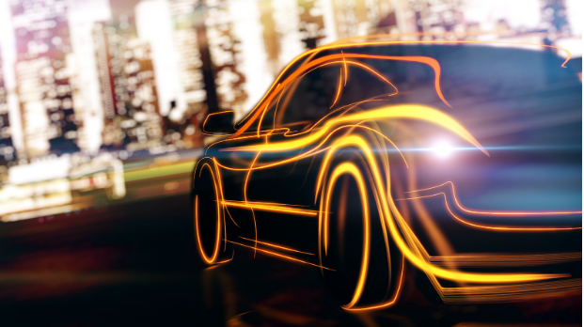
Car
Performance
Prediction
Using
IBM Watson
Machine Learning

Slide 3
1
2
3
4
Introduction
IBM Watson Machine Learning
Problem Statement
Solution
Car Performance Prediction
By Using IBM Watson Machine Learning
Flowchart
5
Software And Languages Used
Problem Solving Flowchart
CONTENT
Prototype
6
For Making Of App
Demo Video
7
Snapshot Of App
8
Video Recording Of Working Of App
Conclusion
9
Future Scope
Result We Get
Of The App

Slide 4
INTRODUCTION IBM WATSON MACHINE LEARNING
Deploy any models including machine learning and deep learning models and decision optimization models.
IBM Watson Machine Learning helps data scientists and developers accelerate AI and machine learning deployment on IBM Cloud Pak for Data. Deploy AI models at scale across any cloud on an open, extensible architecture.
With IBM you can:
2
Dynamically retrain models with continuous learning.
Automatically generate APIs to build AI-powered applications through DevOps.
Manage and monitor models for model drift, bias and risk.
Bring any projects into production, including open source, third-party and IBM tools.

Slide 5
PROBLEM STATEMENT
Predicting the performance level of cars is an important and interesting problem. The main goal is to predict the performance of the car to improve the certain behavior of the vehicle. This can significantly help to improve the system's fuel consumption and increase efficiency.
The performance analysis of the car is based on the engine type, no of engine cylinders, fuel type, and horsepower, etc. These are the factors on which the health of the car can be predicted. It is an on-going process of obtaining, researching, analyzing, and recording the health based on the above three factors. The performance objectives like mileage, dependability, flexibility, and cost can be grouped together to play a vital role in the prediction engine and engine management system. This approach is a very important step towards understanding the vehicle's performance.
3

Slide 6



SOLUTION
By using the given dataset to train machine learning model, model data from pkl file and h5 file to load data into python and flask to launch for development of app.
4
DATA
PREPROCESSING
MODEL
BUILDING
APP
BUILDING

Slide 7
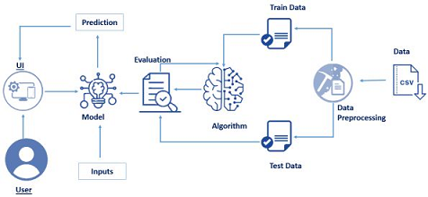
FLOW CHART
5

Slide 8



SOFTWARES AND LANGUAGES USED
SPYDER
JUPYTER
App Building
Model Building
HTML AND CSS
PYTHON
Web Page Development
Flask App
Development

Slide 9
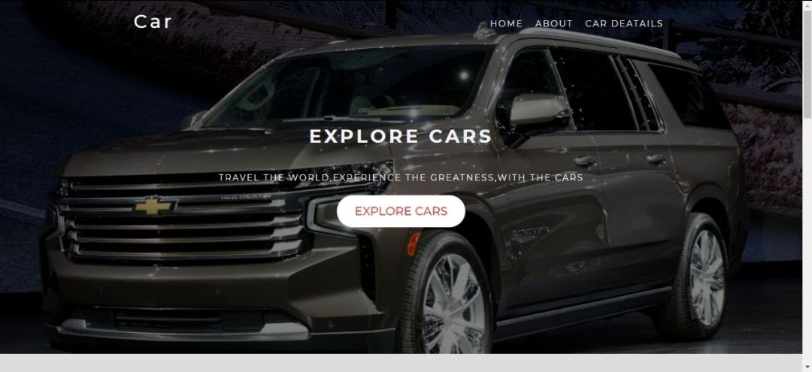
PROTOTYPE
7

Slide 10
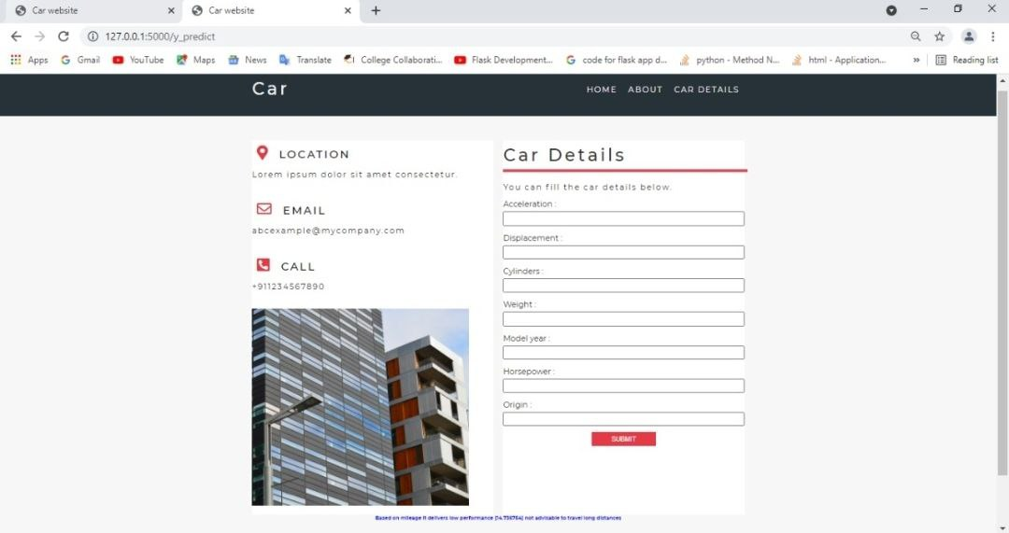
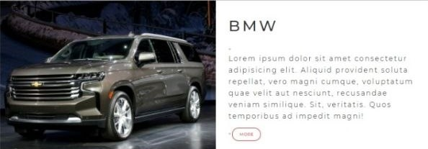
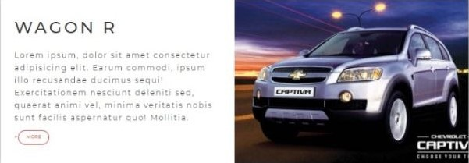
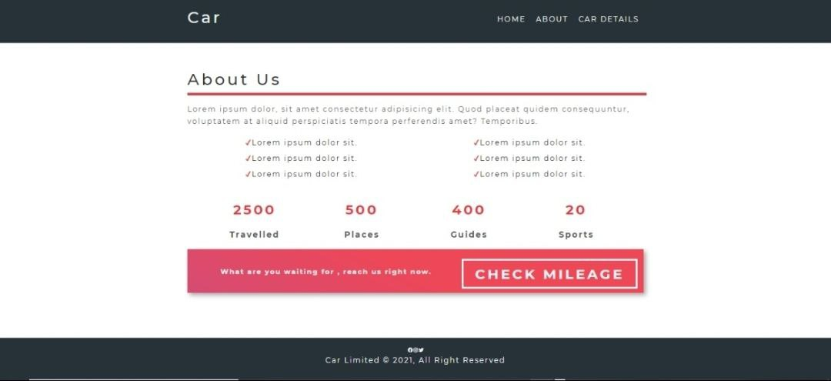
8

Slide 11
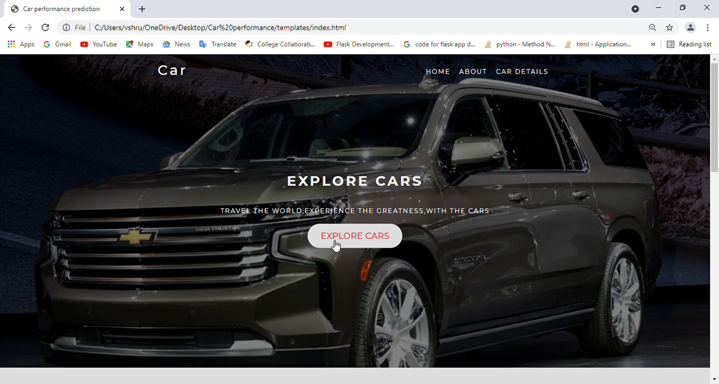
DEMO VIDEO
9

Slide 12
CONCLUSION
Regression Model helps in obtaining the output which involves in creating a clear relationship between the dependent and independent variable. Since the mileage of the car depends on the factors like weight, displacement, horsepower etc which are independent of each other, regression model acts as a better ML algorithm.RNN can not be used because the mileage of one car doesnt depends on the mileage of the other car.
This is a regression kind of problem since mileage has been predicted based on other numerical parameters. This model has been trained using random forest classifier and when data was tested for this model it gave an accuracy of around 87%.The prediction of mileage gives a better understanding of performance and usage of the car.
10

Slide 13
FUTURE SCOPE
Although, this system has achieved astonishing performance in car price prediction problem our aim for the future research is to test this system to work successfully with various data sets with high number of input values to gain more appropriate results.
11

Slide 14
Thanks
Does anyone have any questions?
kale.ahilya2019@vitbhopal.ac.in
v.shruthiy2018@vitstudent.ac.in
navneethb.r2019@vitstudent.ac.in
aryanavicot.john2018@vitstudent.ac.in
dulipudiveera.sekhar2018@vitstudent.ac.in
TEAM
BUG DECIPHERS

